Slide 1
WOMEN’S PARLIAMENTARY NETWORK OF SERBIA
Washington, 10.10.2014.

Slide 2
KEY PREREQUISITES IN FORMING OF PARLIAMENTARY NETWORK
1. Women represent 51,3% of Serbian population
2. Increasing number of women in Serbian Parliament in period from 1990 (1,6%) till 2012 (33%)
3. National assembly of the Republic of Serbia adopted several very important laws in recent period:
- Anti – discrimination law, March 26, 2009
- Law on gender equality, December 11, 2009
- Amendments to the law on election of deputies, May 25, 2011, which implemented the principle that at least 33% of members of parliament must be women

Slide 3
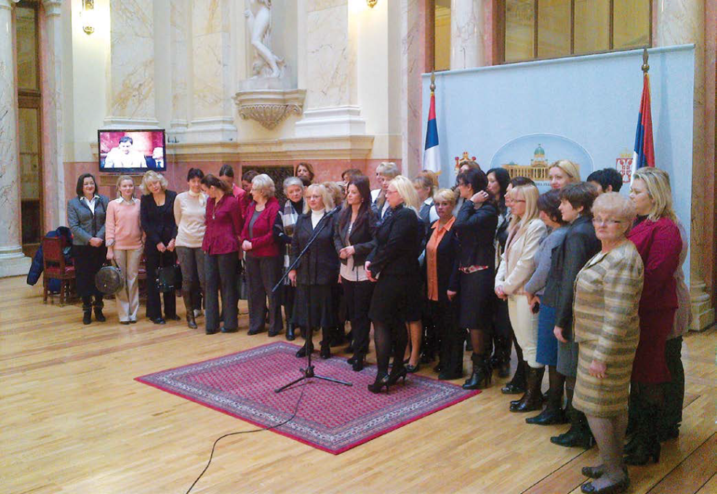
WHEN WAS THE WOMEN’S PARLIAMENTARY NETWORK ESTABLISHED?
For the first time in the Serbian parliamentary history, the women’s parliamentary network was formed on February 14, 2013 by the unanimous decision of all women members of the parliament, thus neglecting their party affiliation in order to achieving more important goals.

Slide 4
STRUCTURE OF THE WOMEN’S PARLIAMENTARY NETWORK IN SERBIA
It is organized as informal group represented by the “Collegium” consisting of 12 coordinators (each one of them representing one parliamentary group). “Collegium” is involved in all discussions and in making all decisions as well as in informing other female members of the parliament about them.
“Collegium” is presided by one of the coordinators over the period of three months. The main criteria for choosing the chairman is the size of the parliamentary group.

Slide 5
MAIN GOALS OF THE WOMEN’S PARLIAMENTARY NETWORK IN SERBIA ARE:
Adopting new laws and politics as well as supervision of implementation of existing laws, especially in following areas:
-Women’s and family health
-Suppression of violence against women and children as well as of domestic violence
-Economic empowerment of women
-Education of women and promotion of women’s knowledge
Other priorities are:
-encouraging women in Serbia to take more active part in country’s political and public life
-raising awareness of women’s solidarity
-promotion of gender equality at all levels

Slide 6
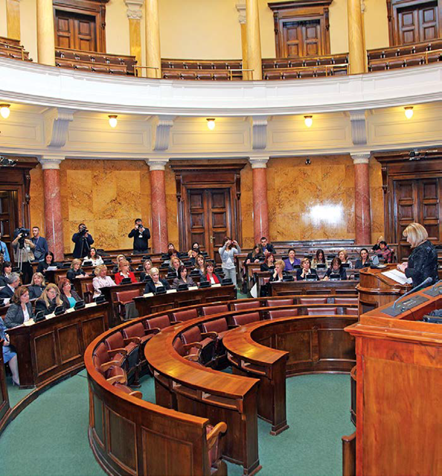
ACTIVITIES OF WOMEN’S PARLIAMENTARY NETWORK IN SERBIA:
● Conference ‘’Position of women in Serbia‘’ in March , 2013 was the very first event where Women’s parliamentary network was represented to the public.

Slide 7
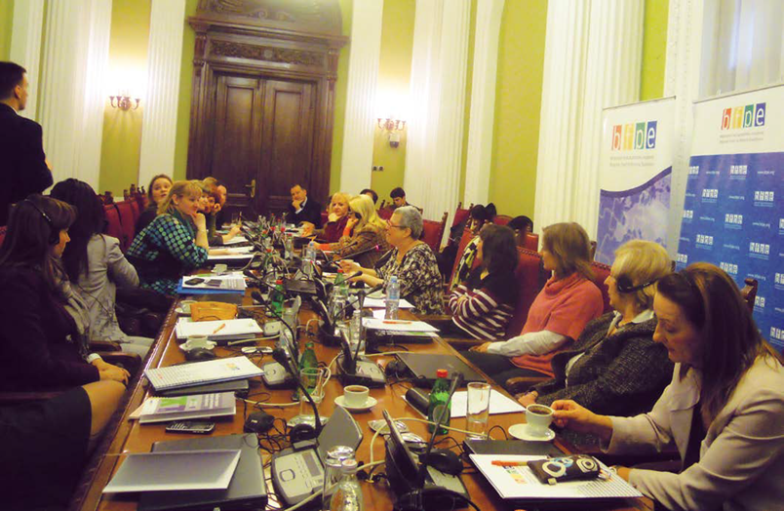
● In April 2013, OESC Mission in Serbia and Belgrade fund for political excellence organized lecture held by Ms. Ana Snitova, the director of program in gender studies of New school, USA, for members of Women’ s parliamentary network about tactics and strategies used by women’s groups in parliament.

Slide 8
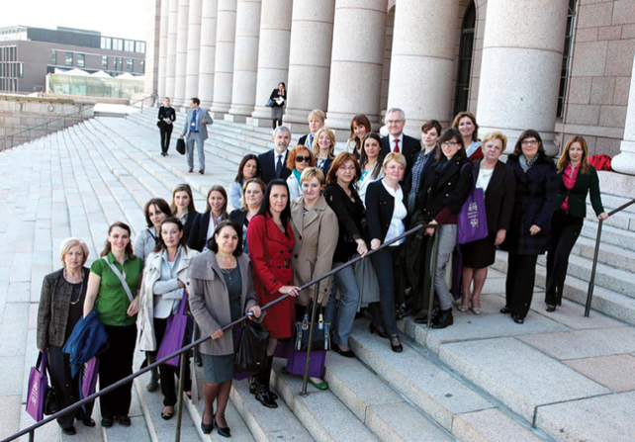
● In May 2013, the Women’s parliamentary network’s delegation, consisting of 20 network’s members, visited Finland in order to share experience concerning similar problems that women in both countries have.

Slide 9
● In July 2013, we have organized the lecture within the walls of the Serbian parliament concerning prevention of cervical and breast cancer. During the course of the lecture different legal possibilities were discussed in order to implement mandatory medical examination in Serbia thus improving general health prevention.
● Women’s parliamentary network, striving to economically empower women, established regular contacts with various entrepreneur associations as well as with organizations dealing with problems of female employment and entrepreneurship in Serbia.
● Members of Women’s parliamentary network took active part in conference on implementation of Resolution 1325 of UN Security Council in order to fully supporting parliamentary supervision of the implementation of the national action plan.

Slide 10
● Official meeting with representatives of LGBT population who urged us to initiate adopting of the Law which would enable changing of unique identification number consequently to the sex change.
● Members of Women’s parliamentary network significantly contributed to the parliamentary discussion whilst adopting Istanbul Convention in Serbia, using for the very first time message box previously agreed at the meeting of our “Collegium”.
● In December 2013., Women’s parliamentary network organized the first National conference within the walls of the National Assembly of the Republic of Serbia. Three female counselors from each one of 29 different Serbian counties took part in this conference striving to activate as many women as possible within local communities as well as to form local female counselors’ networks.
● Seminar ’’Gender budgeting’’, organized with OESC mission in Serbia aiming to plan the budget, to analyze its effects as well as to get relevant data about economic position of women within local community.

Slide 11
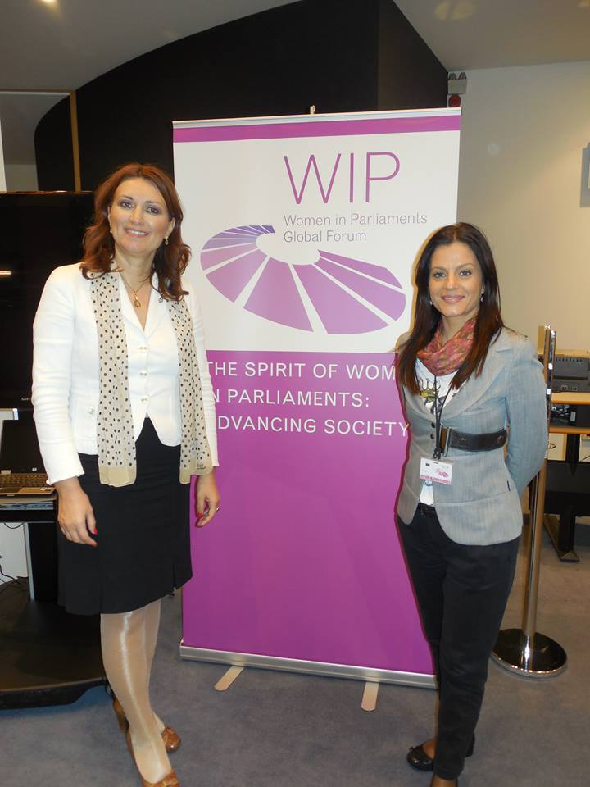
● Women’s parliamentary network delegation of Serbia took part in the international conference “Women in Parliament”, held in Brussels, November 27-29, 2013. Almost 400 female members of parliaments worldwide took part in this conference.

Slide 12
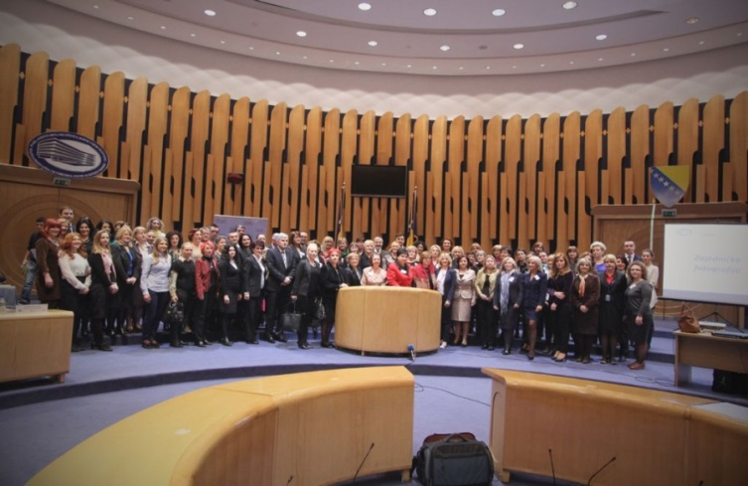
● Women’s parliamentary network’s delegation took part at the international conference “Achievements and challenges from a gender perspective” in Bosnia and Herzegovina, in March 2014.

Slide 13
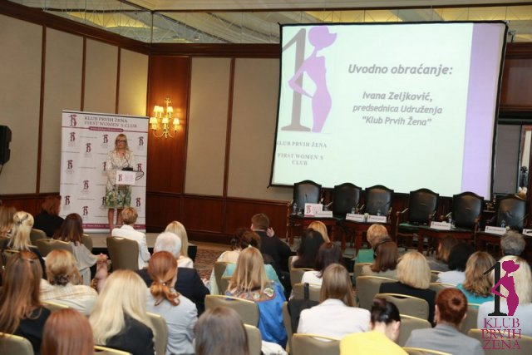
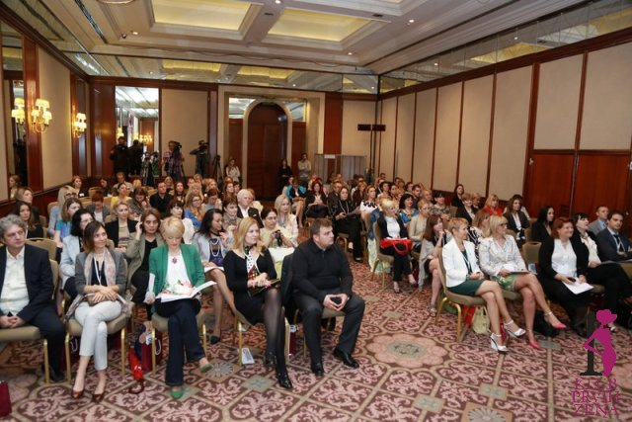
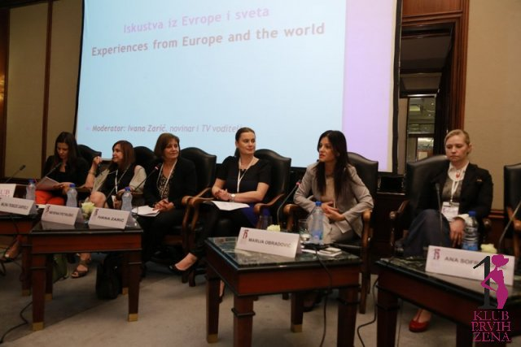
17. Women’s parliamentary network’s delegation took part at conference organized on the occasion of the 20th Anniversary of the founding of First Women’s Club.

Slide 14
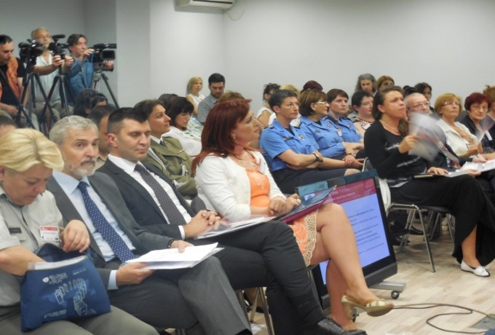
● The representative of Women’s parliamentary network participated at the opening ceremony of the “Women in uniform” conference, organized by non government organization FOSDI on 24 and 25 June, 2014.

Slide 15
ACHIEVED RESULTS OF THE SERBIAN WOMEN’S PARLIAMENTARY NETWORK:
1. Criminal Law was amended in the procedure initiated by members of Women’s parliamentary network thus preventing obsolescence of sexual criminal offences against children. Serbia became second European country, after UK to do this.
2. As a result of the First National Conference held in Belgrade on December 1, 2013, Women’s parliamentary network was also established in Parliament of AP Vojvodina and also more then 40 women’s counselors networks were formed within municipalities in Serbia.
3. Establishing of the Women’s parliamentary network as well as its activities found place in the positive report of European Commission on Serbia, issued on June 1, 2013.
4. Significantly better representation of Women MPs in Committees of current Parliament’s convocation is result of efforts of Women’s Parliamentary Network:
- IX convocation (2012-2014): only 11% of women MPs were members of Committees,
- current X convocation: 33,4% women MPs are Committee’s members.

Slide 16
PLANS OF WOMEN’S PARLIAMENTARY NETWORK IN SERBIA:
1. Continuation of activities of Women’s Parliamentary Network during current Parliament’s convocation as well as continuation of cooperation with institutions and organizations whose primary goal is better position of women in our society.
2. Organization of the First Regional Conference in National Assembly of the Republic of Serbia during fall this year in order to share different experiences and to connect women from the region , as well as of 2. national conference on November 2014.
3. Initiating new legal solutions striving to achieve gender equality and promoting women’s entrepreneurship as one of the key factors of economic growth.
4. Signing of National Assembly’s Memorandum of Understanding supporting growth of women’s entrepreneurship in Serbia, in November 2014, jointly sponsored by Women’s Parliamentary Network, Association of Business Women of Serbia and European Commission’s office in Belgrade.

Slide 17
CHALLENGES OF THE WOMEN’S PARLIAMENTARY NETWORK:
1. In front of us is a difficult task of demolition of political, social and economical stereotypes which are still predominant in Serbian society.
2. Involvement and engagement of as many women as possible in executive structures and in local policies. Current state of affairs is that only 8% of mayors in municipalities are women.
3. Our goal is to create amendments regarding Law on Ministries aiming to implement the same rule as in Parliament, minimum 30% women in governing bodies.
4. Better media visibility of Women’s Parliamentary Network in Serbia.

Slide 18
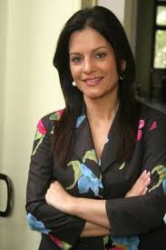
THANK YOU FOR YOUR ATTENTION!
Marija Obradovic Dubravka Filipovski
marija.obradovic@parlament.rs dubravkafilipovski@gmail.com
zpm@parlament.rs

