Slide 1
League of Tunisian Women Voters
(Ligue des Electrices Tunisiennes, LET)
Tunisian Women:
Political role, Gains and Challenges
Prepared and presented by Basma Soudani Belhadj (President and founder of LET)
and
Najla Abbes (board member and co-founder of LET)

Slide 2
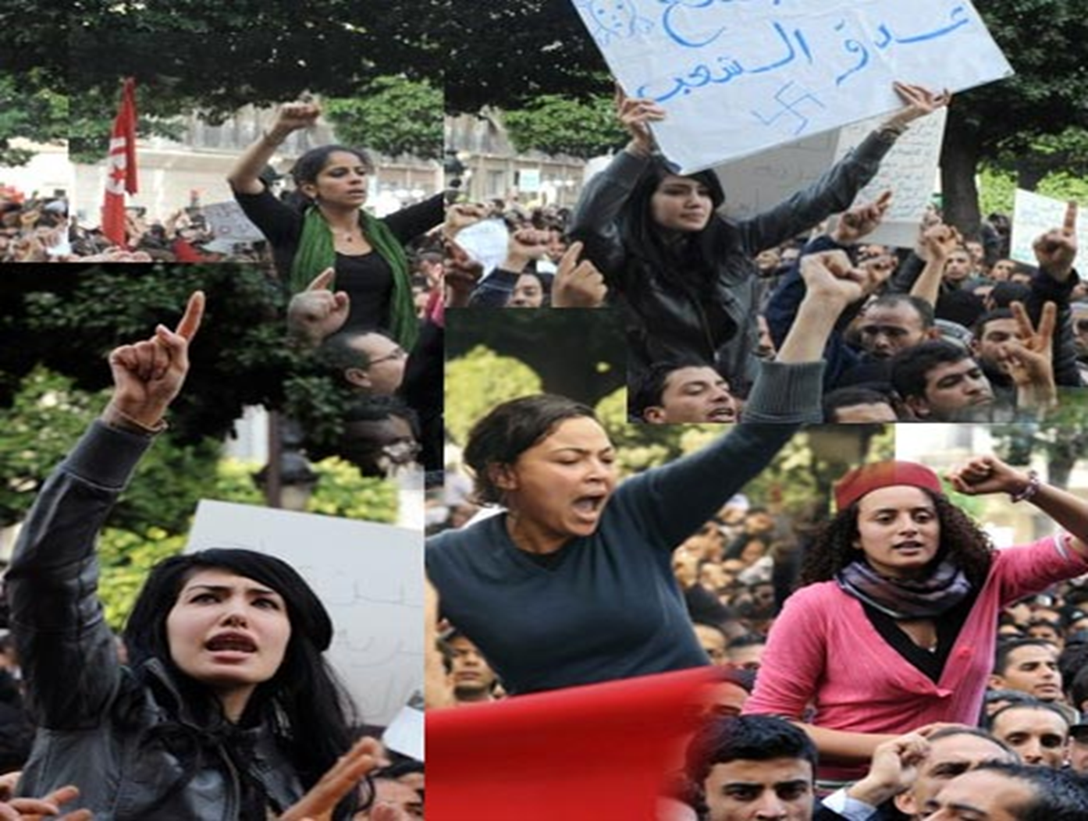
During the uprising (December 2010 -January 2011) , women have been able to experience the equal citizenship which resulted in a very strong participation in the protests both in real and the virtual space.
Hence, women were the human rights activists, the trade unionists, the opposition politicians, the bloggers, the protesters, etc…
However, religious and identity claims questioning the "civility" of the state and the emancipation of women soon emerged.
In this context marked by political positions and ideological conflicts, attitudes towards gender equality ranged from defenses, threats and new conquests.
In addition, women’s participation was considered as the best defense against obscurantism

Slide 3

PARITY & ALTERNATION
in the electoral lists
Progressive activists and feminists fought for the inclusion of gender equality in the electoral law of the NCA to ensure adequate representation of women in the assembly in charge of drafting a new social and political pact for Tunisia.
This mobilization was successful with the adoption of the Decree of 10 May 2011 where the Article 16 instituting parity and alternation in the electoral lists marked a significant step forward in Tunisia, in the region, and in the image of the revolution.
In this context marked by political positions and ideological conflicts, attitudes towards gender equality ranged from defenses, threats and new conquests.
Parity continued to be the subject of debate and did not seem to produce the desired quantity and quality effects. A negative message for gender equality in Tunisia emerged from the results of the 23 October elections.

Slide 4
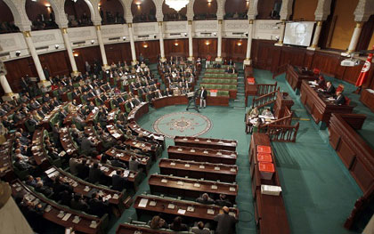
The struggle for parity in the electoral lists was one of the major challenges for the cause of gender equality.
Decree-Law of 10 May 2011 concerning the election of the National Constituent Assembly was characterized by an innovative element according to which Article 16 of the Act establishes parity in candidacy between men and women , with alternating male and female names in the electoral lists and cancels the lists that do not respect this rule.
The elections results of the NCA have demonstrated the limits of the campaign and the risk of regression endangering the Tunisian modernist project.
E.g.: All the instances of transition that were implemented during the transitional period before the elections of October 23, 2011 had a gender unequal composition and were directed by men without exception.

Slide 5
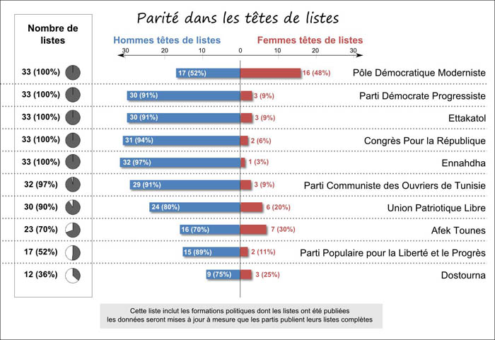
PARITY & ALTERNATION
in the electoral lists
Democratic Modernist Pole applied parity at the heads of lists with 16 women at the head of its 33 lists.
Ettakattol party of Mustapha Ben Jaafar has meanwhile managed to have four lists among its 33 presided by women.
The Congress for the Republic (CPR) , Moncef Marzouki, has presented one woman at the top out of its 33 lists.
The Democratic Progressive Party led by Maya Jribi presented three women at the top of its list.
The Nahda movement, meanwhile has placed one non-veiled woman as head of list.
This symbolic gesture reveals the absence of a genuine conviction of parity within the party, which seems rather to respect the parity but in a second position.
It is precisely against the political marginalization of women and in order to increase their participation in the process of transition that the Tunisian Association for Democratic Women ATFD led the campaign " Do not let them steal your voice” and the League of Tunisian Women Voters was born in August 2011.

Slide 6
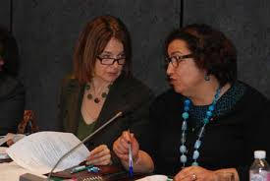
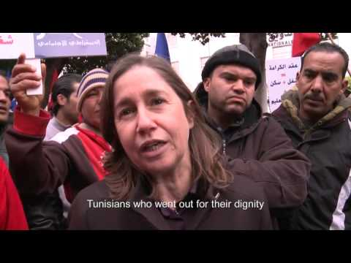
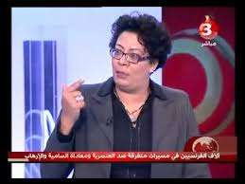
Image of Tunisian Women Politicians
The campaigns of intimidation and denigration against progressive women since January 14, especially in social media played against those candidates.
It is also important to point out that the lack of media coverage for women during the elections campaign was significant too.
Women political actors, or party candidates or heads of lists, occupied a small space in the media coverage. It is 2.02% in the press, of 4.92 % on radio stations and 2.02 % on Television channels.
The media marginalization of women is not new, this is unfortunately a tradition in Tunisia.

Slide 7
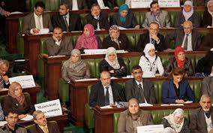
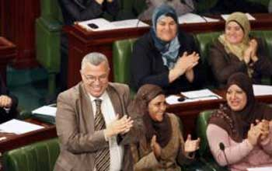
Election results
59 women made it to the Constituent Assembly. They represent 27% of the 217 elected.
Because it won several seats in each constituency, the Islamist Nahdha party is the one who brings the most women in the Chamber (89 out of 217 seats ).
Among the 59 women elected, 42 are members of the Nahdha party.
As for women's participation in the constituent within the six NCA commissions, only the Commission on Human Rights and Freedoms is chaired by a member of the parliamentary group of the Nahda.
Based on this under-representation of women in the NCA and the government, the risk of regression for women's rights emerges in particular from the general political context and the profile of the winner.

Slide 8
Amendment to Article 45 in the constitution
2014 has been a decisive year for the future of Tunisia and Tunisian women and men. The adoption of the new constitution and the holding of legislative and presidential elections will determine the direction of Tunisia for several generations.
Citizen vigilance and mobilization of the civil society and the democratic parties played an important role to defend the humanist and egalitarian message of the revolution.
The best example is the amendment to Article 45 that the NCA passed in the constitution protecting women’s rights and seeking to ensure gender parity in elected government.
The difference in number between the deputies for and against the amendment was very close. 9 women deputies from the Islamic party Nahdha voted against.
The amended article reads: “The state guarantees the protection of women’s rights and supports the advances therein. The state guarantees equal opportunities for women and men to take on various responsibilities across domains. The state strives for gender parity in all elected councils. The state takes all necessary measures to eradicate violence against women.”

Slide 9
The role of Civil Society
This amendment is the fruit of a very strong advocacy campaign conducted by the civil society with a significant participation from LET. Together with a number of other feminist associations, we (League of Tunisian Women Voters) developed a group of recommendations among which was the parity in all elected councils given that the constitutional draft did not make any reference to parity in the first place.
A day before the voting on women’s rights Article 45, The League of Tunisian Women Voters with other associations that defend women’s rights organized a demonstration in front of the NCA to ask for constitutionalizing the equality between men and women and parity in all the elected councils.
During the demonstration, a group of women activists was allowed to enter the NCA and present the recommendations to a large number of deputies and journalists.
The following day, the article 45 was positively amended as stated above.
We consider this a successful step towards the gain of parity. Despite the wording « the state strives to… » instead of firmly establishing it, we acknowledge that it is now the role of the civil society to advocate for applying parity as a must and not an option.

Slide 10
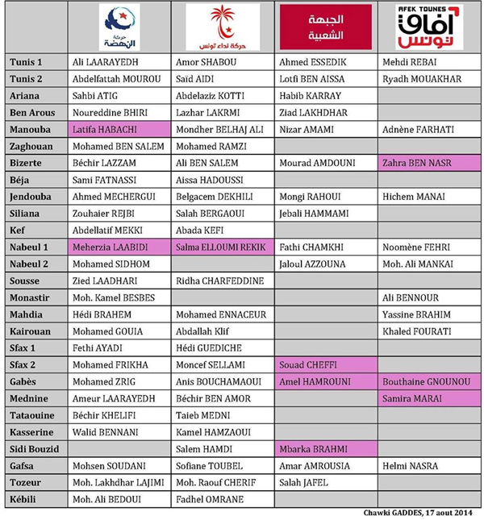
The new electoral lists for the legislative elections October 26th, 2014
The first test for the implementation of parity in the constitution was the electoral law.
The electoral law kept the gender alternation in the electoral law while rejecting the adoption of the parity horizontally, i.e.: at the level of the heads of lists.
March,8th 2014, during the International Women’s Day, feminist associations headed by LET and ATFD, presented a chart to the heads of different political parties asking them to sign a chart promising the adoption of the principle of parity horizontally and vertically in all their lists.
Only the party Nidaa Tunis, through its secretary general signed the chart, but surprisingly, that party presented only one list headed by a woman out of its 25 electoral lists. The rest of the parties presented between 1 and 3 lists headed by women.

Slide 11
Women’s political rights between theory and practice
Article 34:
“The rights to elect, to vote and to run for elections are guaranteed in
accordance with the law. The State shall guarantee the
representation of women in the elected assemblies”.
There is a political schizophrenia that is reflected in the discrepancy between the law and its implementation for the parties that claim to support gender equality and women political participation during their electoral campaigns and the extent to which they abide by those principles in practice.
2014 demonstrated the incapacity of women’s struggle to establish an egalitarian society with equal representation of men and women in the upcoming parliament (that will be elected on October 26th)

Slide 12
Thank you for your attention

